Slide 1

From Shepherd to King – 2 Stories

Slide 2
David - From Shepherd to King – 2 Stories
1. David is chosen as king. 1 Samuel 16-17
  God saw David with the potential of a king.
Psalm 78:70–72 (NIV) He chose David his servant and took him from the sheep pens; from tending the sheep he brought him to be the shepherd of his people Jacob, of Israel his inheritance. And David shepherded them with integrity of heart; with skillful hands he led them.

Slide 3
  Others did not see David with the potential of a king.
2. David goes into God’s training camp to be trained as a King

Slide 4
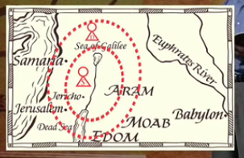

Slide 5
  Others did not see David with the potential of a king.
2. David goes into God’s training camp to be trained as a King
3. David as king points to “the One” Who will come as the Messiah (Jesus).

Slide 6
Application
God wants to use us like he did David. He wants to use us to point others to Jesus.
Don’t underestimate the young people in our congregation. Remember, David was only 16 years old when God first came to him.
God doesn’t choose us by our outward appearance, but he looks at our heart.
We need at least one Jonathan in our lives, who sees God’s good plan for us and believes in us.
If God is going to use us, it will certainly involve a season or two of testing and equipping.
We must keep pointing people to God no matter what season we’re in.

Slide 7
Let’s Pray…

